Slide 1

Mobile Technology and Communication in the Workplace
BCOM 214 FA17 001
Brennen Herr
December 8th, 2017

Slide 2




Overview of Mobile Technology in the Workplace
z
z

Slide 3

Smartphones
Limitations
Security Issues

Slide 4

The Effects of Mobile Technology on Employee Communication

Slide 5

Benefits Of Mobile Technology

Slide 6
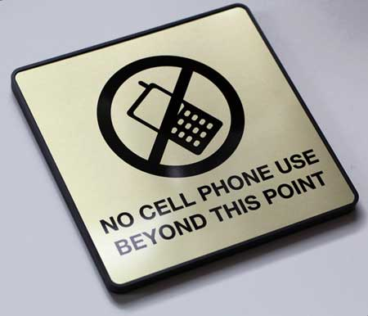
Shortcomings of Mobile Technology

